Slide 1
1-D simulation with COMSOL
Hans Bruining

Slide 2
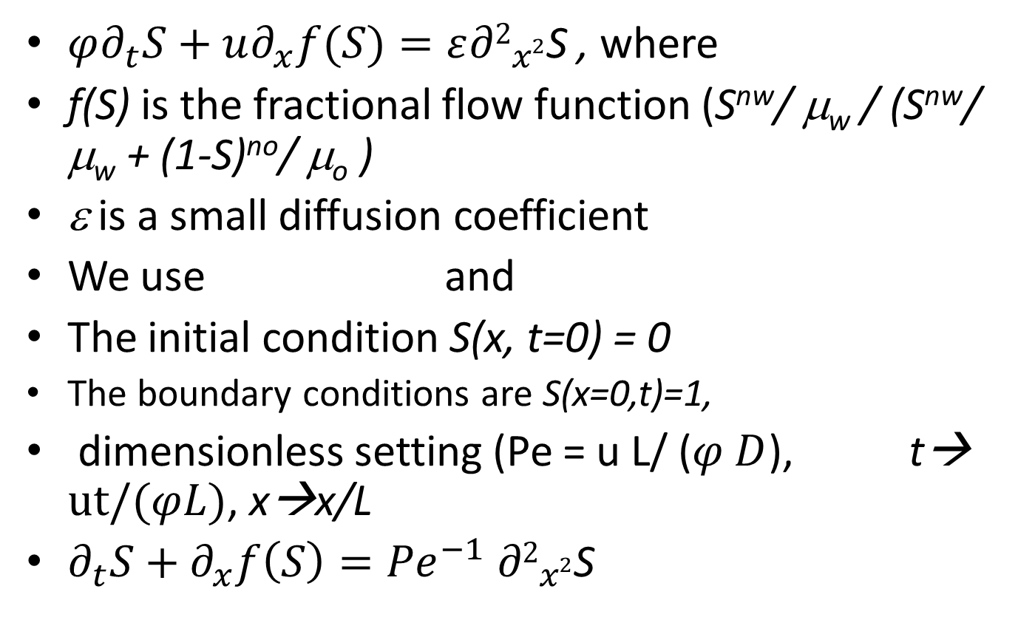
Example 1: Buckley Leverett
$φ∂_{t}S+u∂_{x}f(S)=ε{∂2}_{x2}^{}$S , where
f(S) is the fractional flow function (S^{nw}/ μ_{w} / (S^{nw}/ μ_{w} + (1-S)^{no}/ μ_{o} )
ε is a small diffusion coefficient
We use and
The initial condition S(x, t=0) = 0
The boundary conditions are S(x=0,t)=1,
dimensionless setting (Pe = u L/ ($φ D$), t→ $ut/(φL)$, x→x/L
$∂_{t}S+∂_{x}f\left(S\right)={Pe}^{−1} {∂2}_{x2}^{}$S

Slide 3
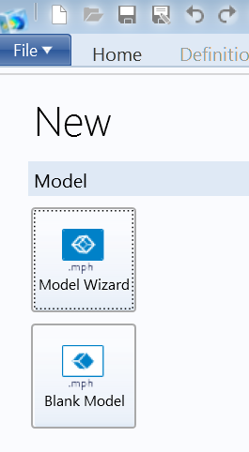
How to start?
Press
Model wizzard

Slide 4
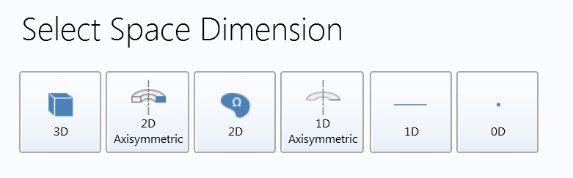
How to start-2?
Select 1-D

Slide 5
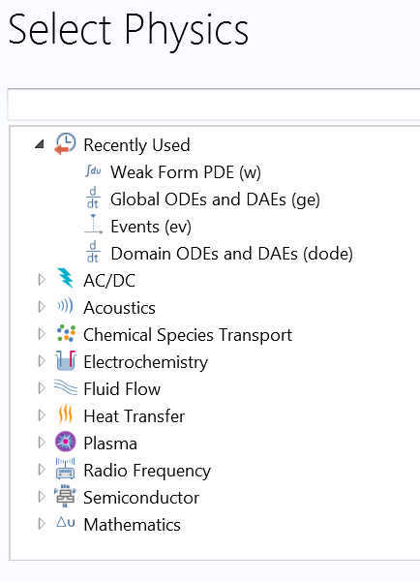
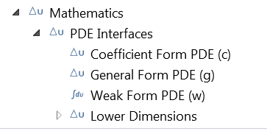
How to start?
Press mathematics →
Press Δu PDE Interfaces →
Press Weak form PDE(w) →
Press +,
Change field name “u” and dependent variables name “u” into “s”

Slide 6
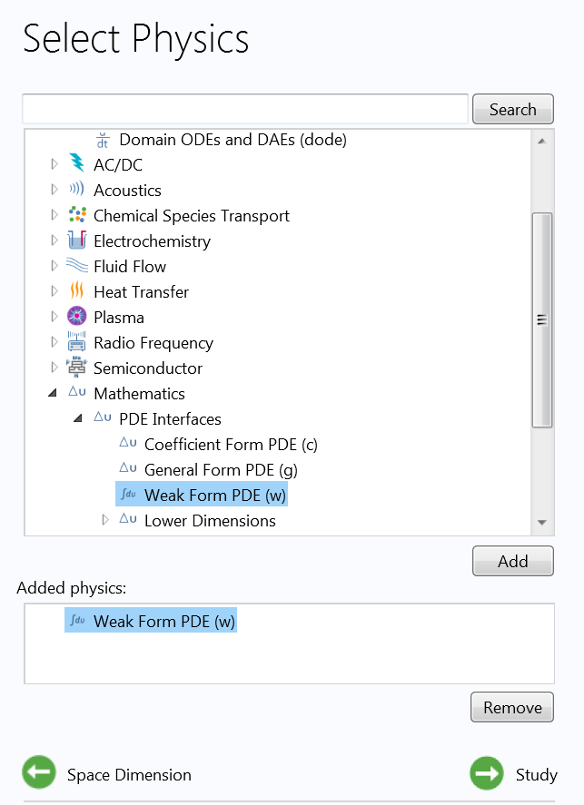
How to start?
Press mathematics →
Press Δu PDE Interfaces →
Press Weak form PDE(w) →
Press Add,
Change field name “u” and dependent variables name “u” into “s”

Slide 7
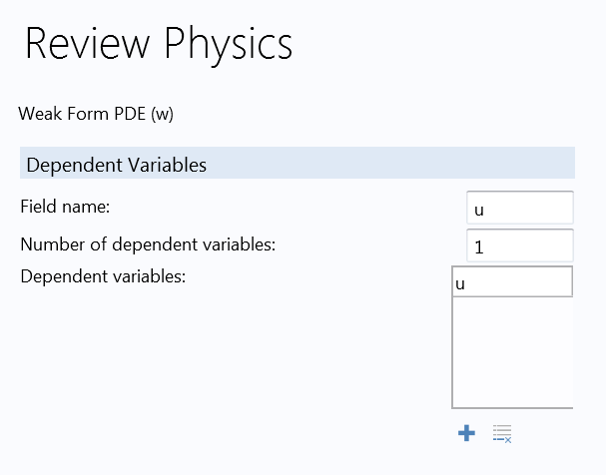
How to start?
Press mathematics →
Press Δu PDE Interfaces →
Press Weak form PDE(w) →
Press Add,
Change field name “u” and dependent variables name “u” into “s”

Slide 8
How to start?
Press mathematics →
Press Δu PDE Interfaces →
Press Weak form PDE(w) →
Press Add,
Change field name “u” and dependent variables name “u” into “s”
Press study

Slide 9
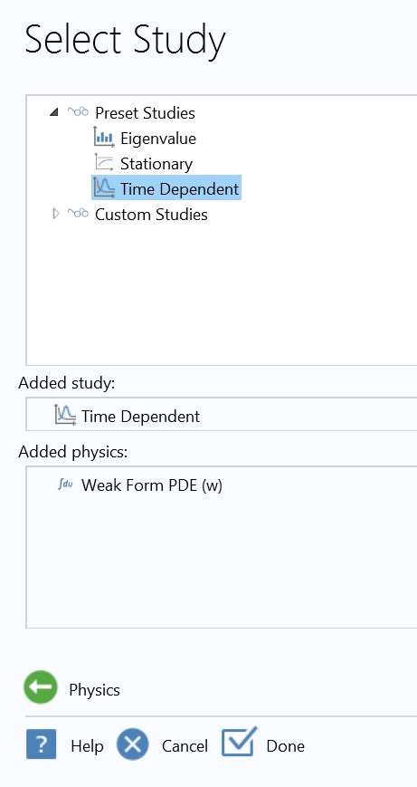
How to start?
Press Time Dependent →
Press Done

Slide 10
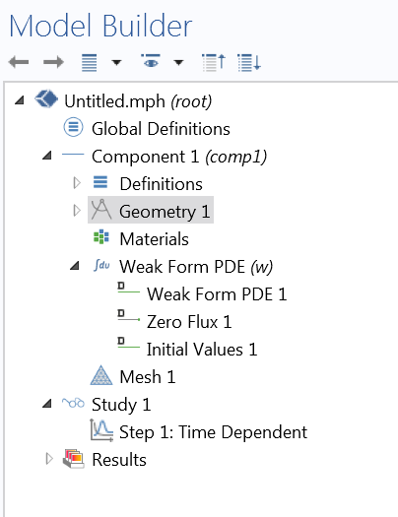
How to start?
Use menu

Slide 11
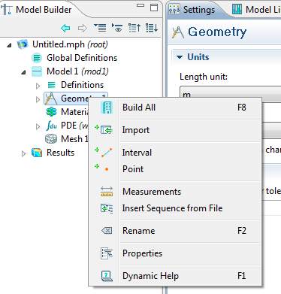
How to start?
Right click on geometry in left panel →
Click on interval

Slide 12
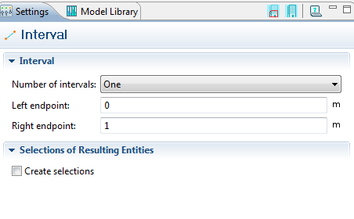
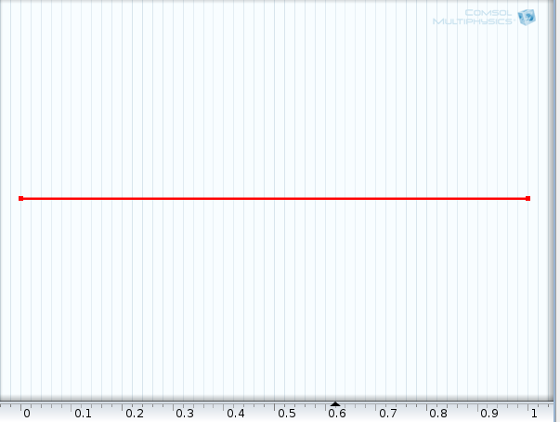
How to start?
Press
Build selected or build all
After build →
A line will appear in the right panel

Slide 13
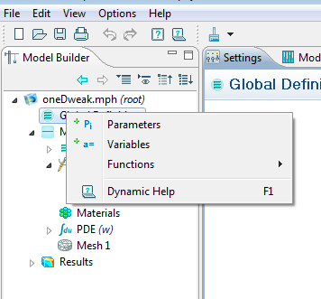
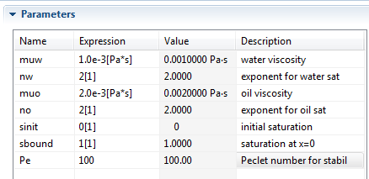
Put in relevant parameters
Right click Global definition →
Click parameters →
Put in parameters

Slide 14
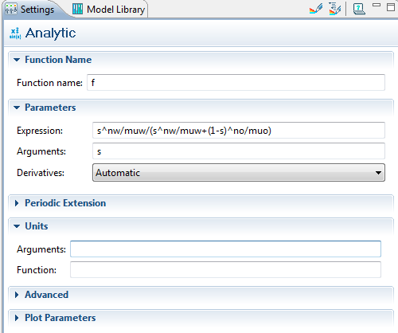
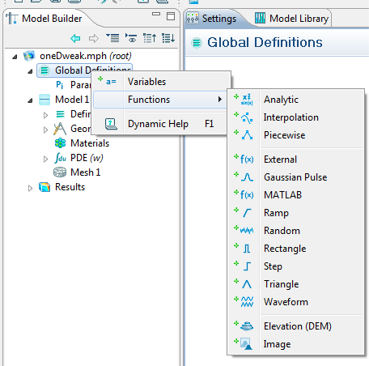
Put in fractional flow function
Right click Global definition → Click Functions →
Click Analytic → Click plot parameters →
Click to view function f(S)

Slide 15
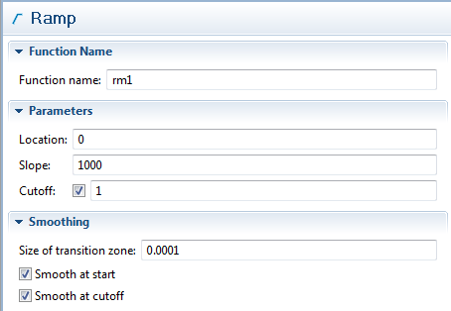
Put in ramp function
Right click Global definition → Click Functions →
Click Ramp → Click plot parameters →
Click to view function rm1(t)
The ramp function will be used to smoothly transit between initial condition and boundary condition

Slide 16
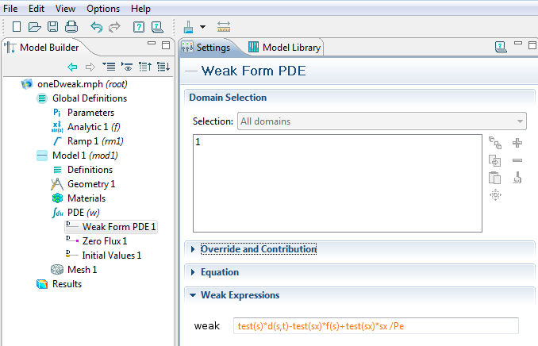
Insert weak form of PDE
Click on int_du PDE(w) →click on “Weak Form PDE 1” →
Substitute in weak: test(s)*d(s,t)-test(sx)*f(s)+test(sx)*sx /Pe

Slide 17
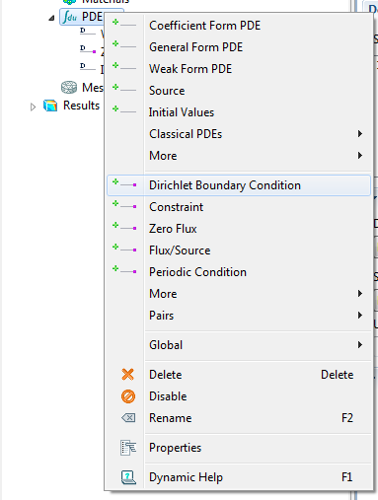
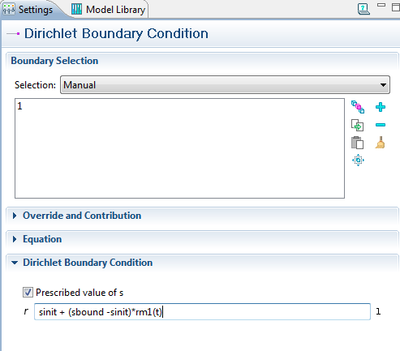
Put in left BC at x=0: s = 1
Right Click on int_du PDE(w) →click on “Dirichlet BC” →
Substitute in “prescribed value of s”: sinit + (sbound -sinit)*rm1(t)
In the graphics panel: click on left boundary point until it becomes a blue square.
Then click “+” until the point “1” is indicated.

Slide 18
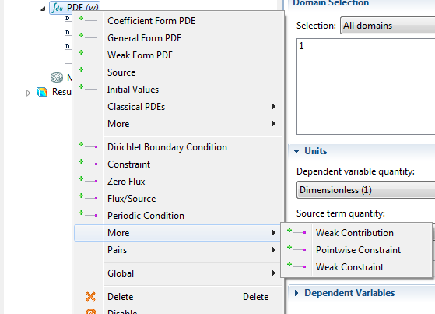
I: Put in right BC at x=1: ∂_{x}s = 0
Right Click on int_du PDE(w) →click on “more” →
Click on “Weak Constraint”
A right BC is necessary as in the numerical scheme we need a diffusion term
∂_{x} (D ∂_{x} S), with appropriate BC

Slide 19
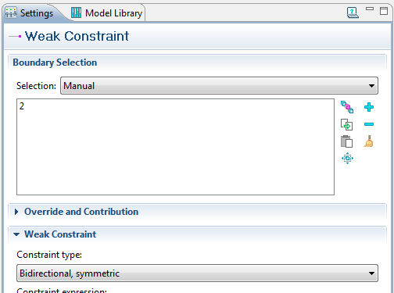
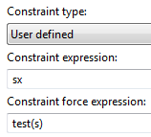
II: Put in right BC at x=1: ∂_{x}s = 0
Right Click on Bidirectional symmetric → click on “User defined” →
Constraint expression: SX → Constraint force expression test(s)
In the graphics panel: click on right boundary point until it becomes a blue square.
Then click “+” until the point “2” is indicated.

Slide 20
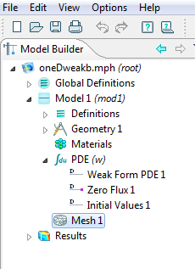
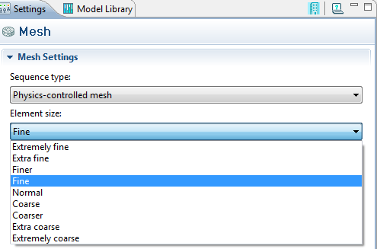


Insert mesh
Click on Mesh 1 →
Sequence type: press Physics-controlled mesh
Element size: type file
Press: build ( ) & centralize ( )
build

Slide 21
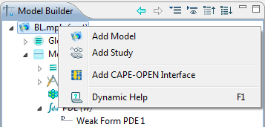
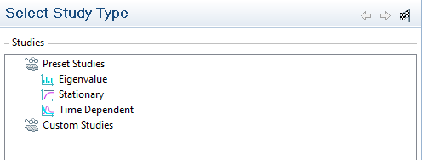

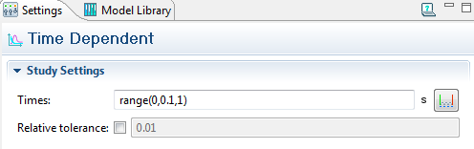
Add study
File → save as → BL.mph
Right click on BL.mph → add study (this may already have happened →
In the select study type panel: choose time dependent → press
Select Step 1: time dependent →Times:
Choose range(0,0.1,1) :
Starting time, output interval, final time.

Slide 22
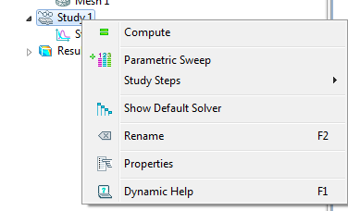
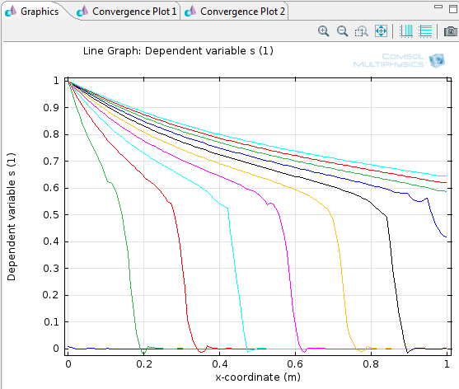
Run: base case sheet-1
Right click study → = compute →
Result is usually displayed automatically
Otherwise:

Slide 23
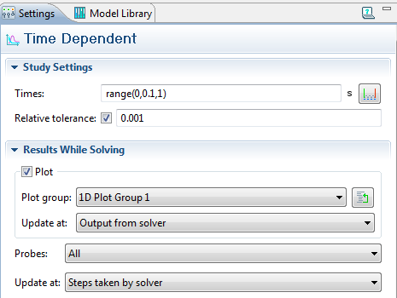
Ways to improve the solution
click study 1 → Step 1 Time dependent →
In study-settings activate the relative tolerance button and modify, e.g. to 0.001
The absolute and relative tolerances control the error in each integration step. For the Unscaled Method, the step is accepted if
where A_{us} is the unscaled absolute tolerance for Degrees of freedom (DOF) i, and R is the relative tolerance, M is the number of fields, N_{j} is the number of degrees of freedom in field j.
U is the unscaled solution vector.
In Results While Solving: activate the Update at: “Output from solver” or
“Steps taken by solver” to follow the solutions while the program is running.

Slide 24
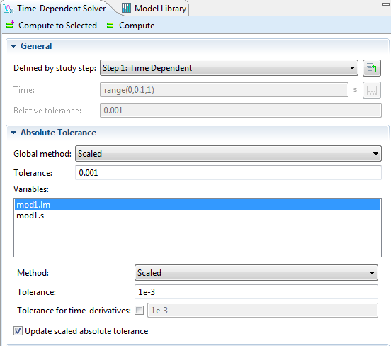
Ways to improve the solution
click study 2 → Step 1 Time dependent →
Solver 3, Time dependent Solver 1
The absolute and relative tolerances control the error in each integration step. For the scaled Method, the step is accepted if
where A_{s,i} is the scaled absolute tolerance for Degrees of freedom (DOF) i, and R is the relative tolerance, M is the number of fields, N_{j} is the number of degrees of freedom in field j. A_{s,i} is computed from the input data
Y is the unscaled solution vector.

Slide 25
Time dependent solver
Use the Time-Dependent Solver () to find the solution to time-dependent problems (also called dynamic or unsteady problems) using the implicit time-stepping methods: BDF or generalized-α.
0 = L(U,U_{t},U_{tt}, t) – N_{F} (U,t) Λ
The Implicit Time-Dependent Solver Algorithms
The finite element discretization of the time-dependent PDE problem is, which is often referred to as the method of lines.

Slide 26
Time dependent solver
If the constraints 0 = M are linear and time independent and if the constraint force Jacobian NF is constant then the algorithm also eliminates the constraints from the system. Otherwise it keeps the constraints, leading to a differential-algebraic system.
In COMSOL Multiphysics, the solvers IDA and generalized-a are available to solve the above ODE or DAE system:

Slide 27
Time dependent solver
IDA was created at the Lawrence Livermore National Laboratory (Ref. 4) and is a modernized implementation of the DAE solver DASPK (Ref. 5), which uses variable-order variable-step-size backward differentiation formulas (BDF).
Generalized-α is an implicit, second-order accurate method with a parameter α or ρ∞ (0 ≤ ρ∞ ≤ 1) to control the damping of high frequencies. With ρ∞ = 1, the method has no numerical damping. For linear problems this corresponds to the midpoint rule. ρ∞ = 0 gives the maximal numerical damping;

Slide 28
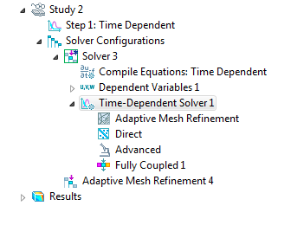

Slide 29
Setting of tolerances
Use Global (default) to apply the tolerance specified for the global tolerance
Unscaled to apply the specified tolerance to unscaled variables
Scaled to apply the specified tolerance to scaled variables
Unscaled to let the absolute tolerance be applied to unscaled variables.
Scaled to let the absolute tolerance be applied to scaled variables.

Slide 30
Absolute tolerance
Specify an absolute tolerance that is used by the solver to control the absolute error. The tolerance specified here is applied to all variables unless modified per variable by selecting another method than the global method for a variable.
Use the Global method list to select how the specified absolute tolerance is to be interpreted for the variables that use the global method (by default, all variables use the global method). Select:
In the Tolerance field you enter a positive number that is applied to either scaled or unscaled variables.
To specify the absolute tolerance individually for a variable, select the variable from the Variables list and modify the corresponding tolerance with the Method list. Select:
If you select either Scaled or Unscaled from the Method list additional fields appear. Use the Tolerance field to modify the absolute tolerance for the selected variable.
If a proble of wave-equation type is being solved and if Method in the Time Stepping section has been set to BDF, then it is necessary to specify absolute tolerances for time derivatives of the variables as well.
By default, the solver chooses a tolerance for these components. To manually enter a tolerance for a time derivative, select the Tolerance, time derivative check box and enter a tolerance in the associated field.

Slide 31
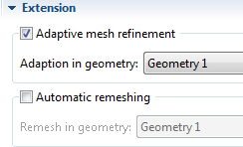
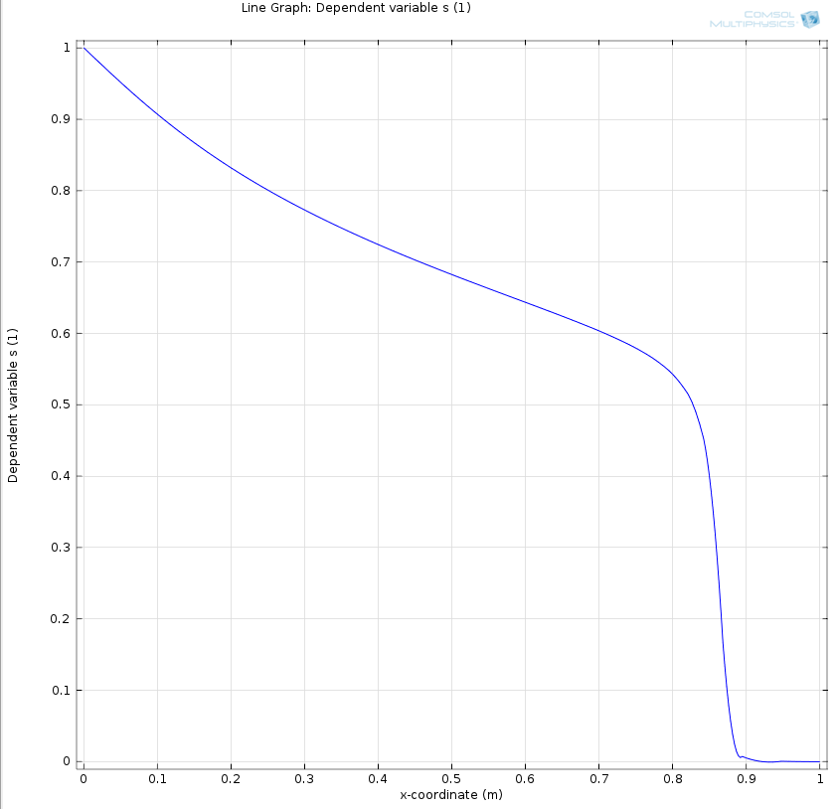
Adaptive mesh refinement Base case sheet -2
In Step 1 time dependent → click extension →
Activate: Adaptive mesh refinement
Right click study → = compute →
Now there is a problem with convergence of solutions that tresspass the downstream boundary:
No problem displace the t=0.6 curve
The following feature has encountered a problem:
Repeated error test failures. May have reached a singularity.
Time : 0.6475
Last time step is not converged.
- Feature: Adaptive Mesh Refinement (sol1/null/t1/taDef)
Error: Repeated error test failures. May have reached a singularity.
Reason, given tolerance not reached after 4 iterations (see for solution a few slides ahead)

Slide 32
Remark on error message
The cause of the error message is that apparently around the time=0.64 seconds a lot of changes happen. What the nature of these changes are I do not know, that is hidden somewhere in your PDE's, I suspect the Dirchelet BC because it uses the x-derivative.
The consequence is that the time-stepping algorithm decides to backtrack a
bit: it will then try to use a solution from the last adapted mesh while it should be using a previous mesh.
To see what happens use this experiment: reduce the stepsize from 0.1 sec to 0.01. Once the riht hand end has been reached the timestepping goes back a few steps and re-uses the various meshes it has created on it's way. To watch what happens during the calculation I have modified:
1) "Study 1>Step 1: Time Dependent>Results While Solving", choose "1D Plot Group 2"
2) "Results>1D Plot Group 2", Time Selection = "Last"
A possible solution is to change "Study 1>Solver Configurations>Solver
1>Time-Dependent Solver>Time Stepping", set the method to "Generalized
Alpha".
You have already mentioned that you are aware of the refinement issues: the gradients over the element boundaries as the solution progresses are quite steep. I have experimented with a brute force approach and disabled the adaptive meshing and simply put in 100 elements, the analysis behaves very gentle and smooth. In fact, it seems almost to run faster because it does not have to go back and forth so much. The solutions at each step are very smooth too. I know that you do not favour this approach and on paper the adaptive method is very elegant but I suggest using more elements.
Best regards,
Gerard Hegemans

Slide 33
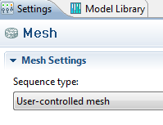
Adaptive mesh refinement
In Step 1 time dependent → click extension →
Activate: Adaptive mesh refinement
Change to User-controlled mesh in the mesh-settings
Right click study → = compute →
Same problem but now we can inspect the meshes
Initial mesh
Sixth mesh

Slide 34
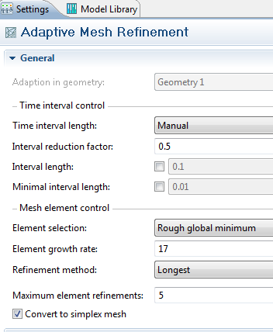
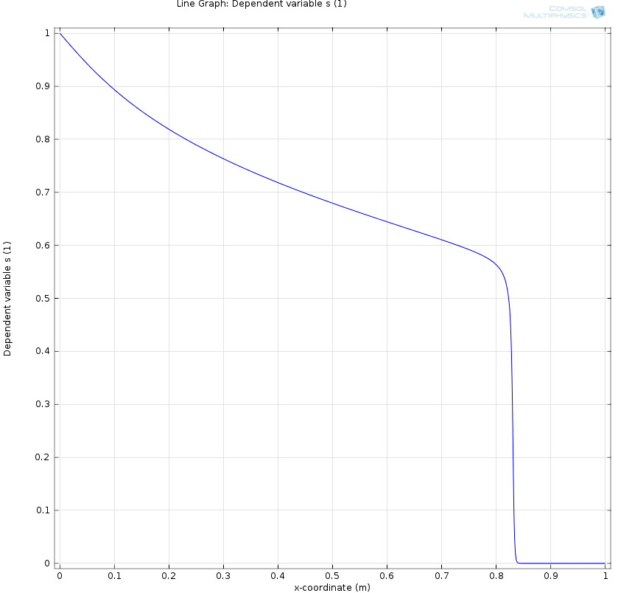
Adaptive mesh refinement
click Adaptive mesh refinement →
choose: Element growth rate : 17
Maximum element refinements: 5
Increase Peclet number in Global definitions → parameters to 500
Right click study → = compute →
Problem with repeated error test failures resolved
Sixth mesh, much finer

Slide 35
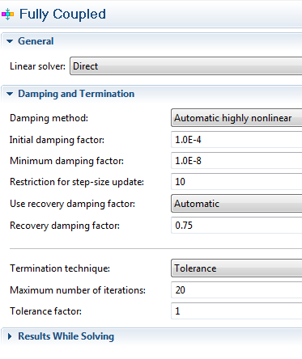
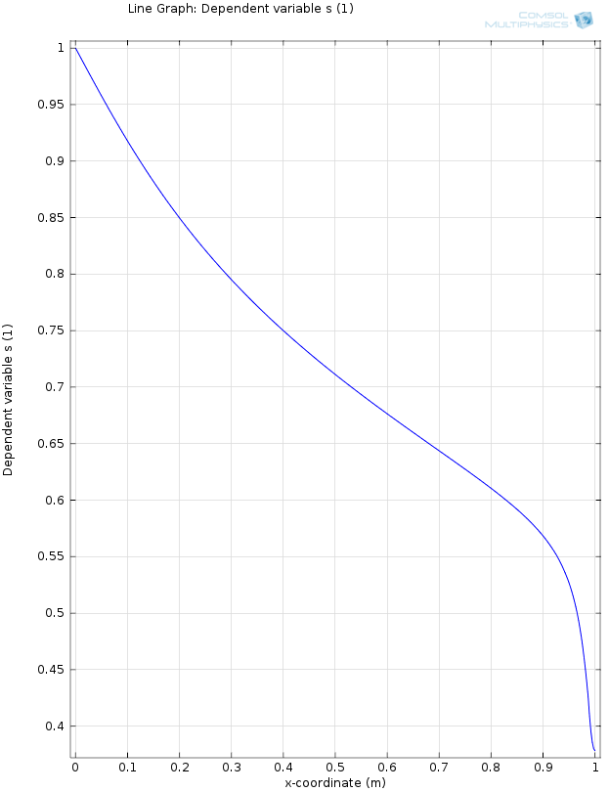
The problem encountered with the first adaptive mesh refinement ( Base case 2) can be solved as follows:
click study → solver configurations → solver → fully coupled
choose: initial damping factor
Increase maximum number of iterations (20)
It may be necessary to choose file →the histrory
Seventh mesh, much finer:
To view the mesh you need to choose the user controlled mesh;
It does not change the mesh distribution

Slide 36
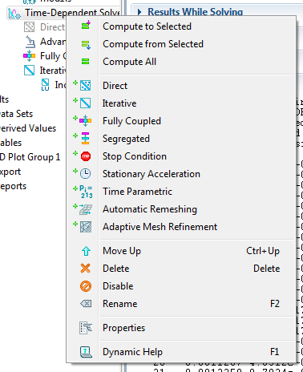
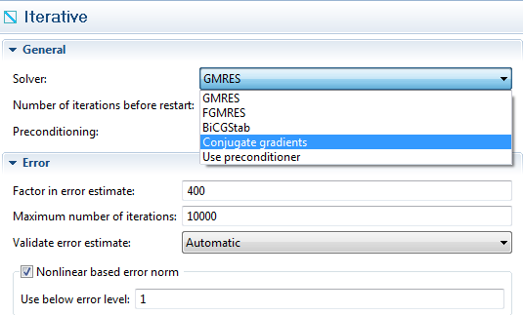
Use iterative solver ( Base case 1)
Right click time dependent solver → iterative →conjugate gradients

Slide 37
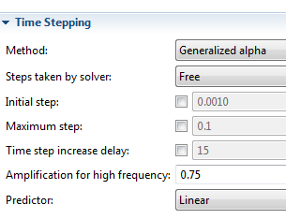
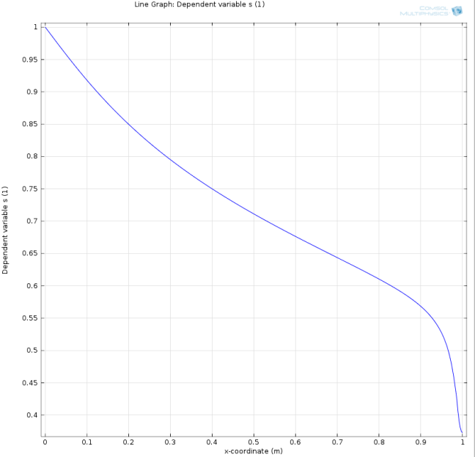

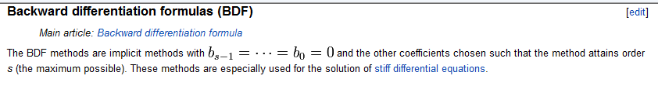
Use other time stepping method ( Base case 1)
Click time dependent solver → time stepping→method: generalized alpha

Slide 38
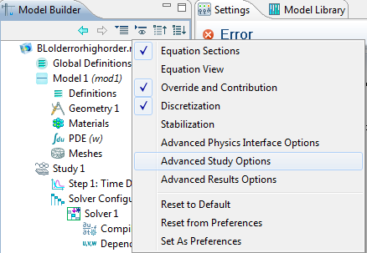
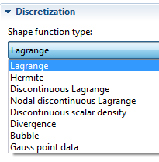
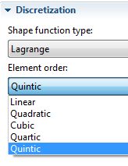
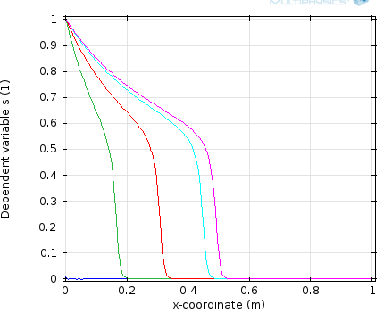
Use higher order elements ( Base case 1)
Click show button → activate discretization → click int_ du PDE(w)
Now the option discretization appears → open menu → choose shape function type, e.g. Lagrangian and choose order, e.g. quintic (5)
Solution looks much smoother, but use one of the other options mentioned before, (e.g., adaptive mesh refinement before) to get convergence.

Slide 39
Procedure
Right click on model 1
Add physics
Add new equation and call variable so
We assume that u = uo + ug + uw=1
Use test(s)*d(s,t)-test(sx)*fw(s,so)+test(sx)*sx /Pe
test(so)*d(so,t)-test(sox)*fo(s,so)+test(sox)*sox /Pe
BC (2)
Weak constraint 1: expression: sox, constraint force expression: test(so)

Slide 40
Procedure Ctd
fw = sw^nw/muw/ (sw^nw/muw+ so^no /muo +(1-sw-so)^ng/mug)
fo = so^no/muo/(sw^nw/muw+so^no /muo+(1-sw-so)^ng/mug)

Slide 41
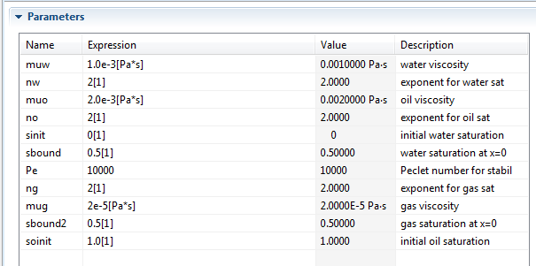
Parameter for system of Eqs.

